Slide 1
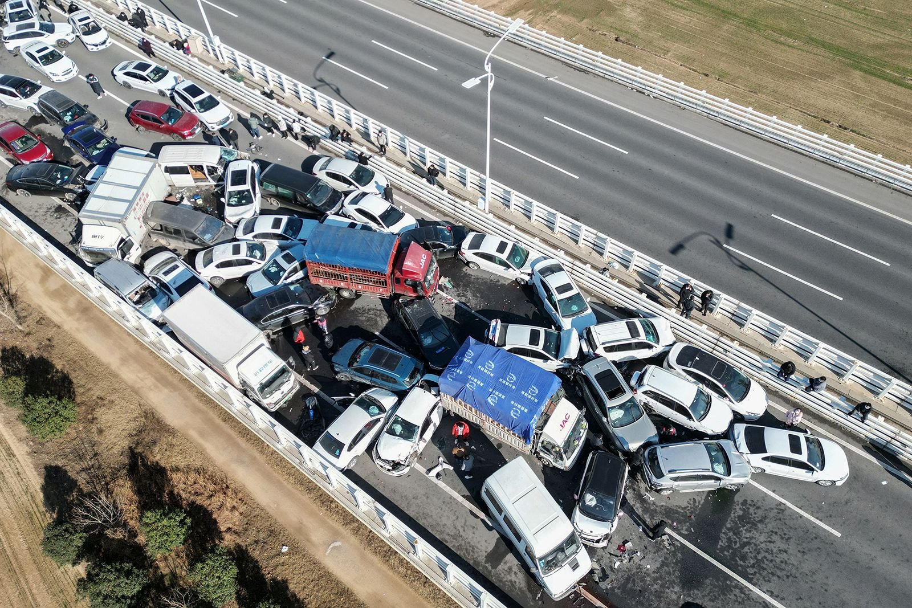
Motor Vehicle Collisions
Author: Daniel Giedraitis
Student Number: C00260331
Module title: Data Visualisation
Date: 17/04/2024

Slide 2
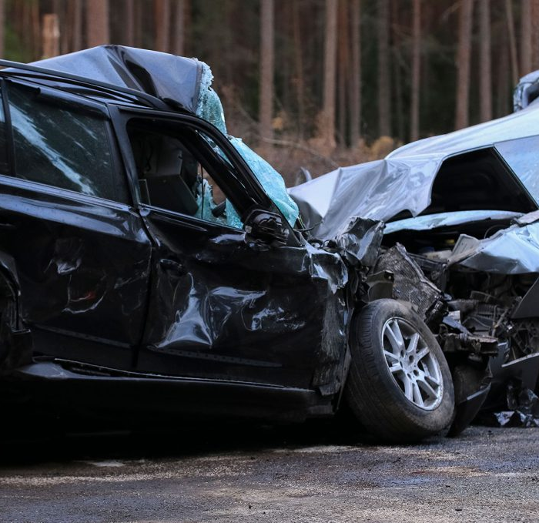
Introduction
Road vehicle collisions have a profound impact, disturbing communities and affecting societal well-being.
This analysis aims to uncover insights into collision patterns, contributing factors, and potential solutions.
By understanding the complexities of road safety, we can work towards reducing the number and severity of collisions.
Data-driven approaches offer a pathway to meaningful interventions and policy reforms.
This analysis seeks to raise awareness, encourage conversation, and drive positive change in road safety practices.

Slide 3
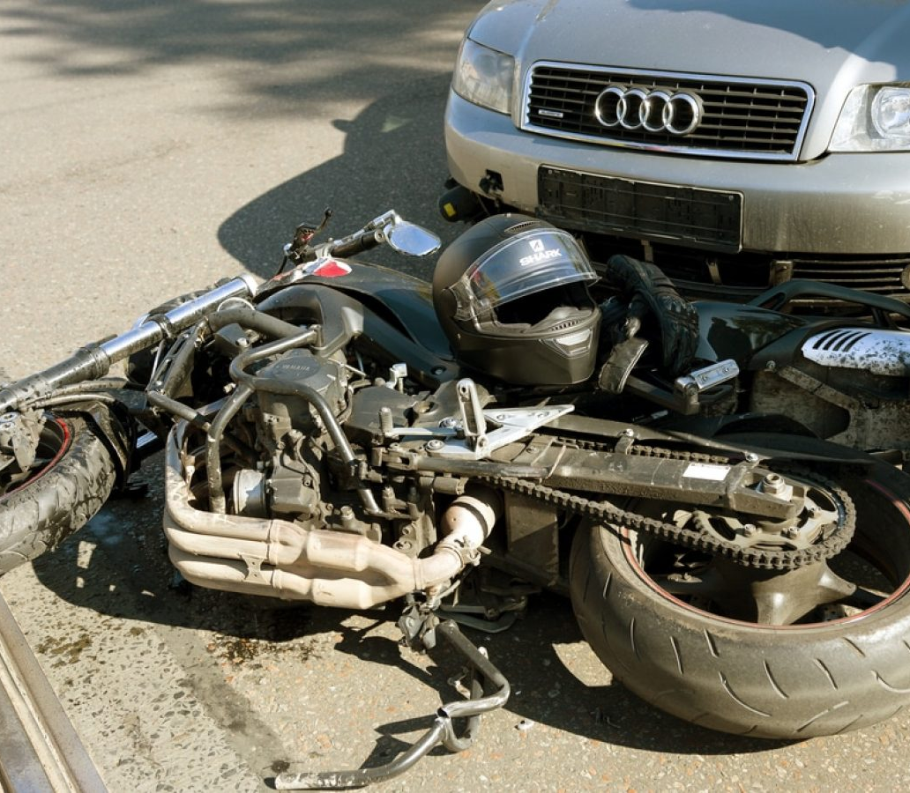
Research Questions / Problem
What are the primary factors driving road vehicle collisions, and how do they contribute to overall accident rates?
How do temporal factors such as time of day, day of the week, and month of the year affect collision frequency and severity?
What insights can be gained from the distribution of injury types resulting from collisions, and how can they inform emergency response protocols?
Are there noticeable differences in collision patterns between urban and rural areas, and what are the implications for infrastructure planning?
These questions guide the analysis, aiming to uncover complex patterns and inform evidence-based interventions.

Slide 4
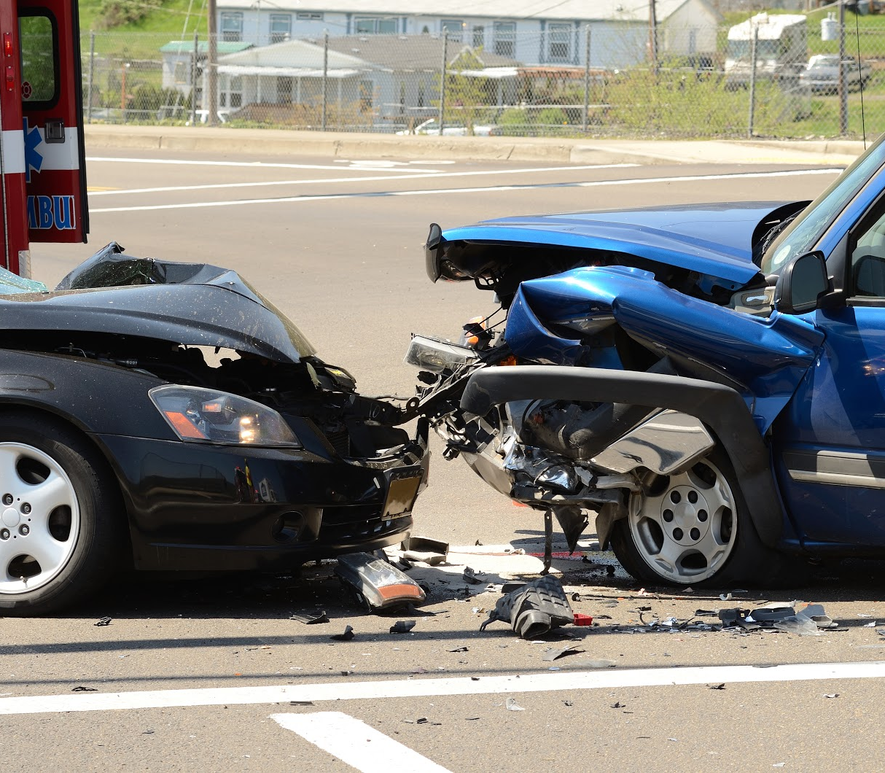
Rationale
Road vehicle collisions impose a significant toll on communities, affecting lives, healthcare systems, and economic vitality.
Data visualization serves as a powerful tool to bridge the gap between raw data and valuable insights.
Evidence-based strategies are essential for addressing the critical public health and safety issue of road traffic incidents.
By shining a light on underlying factors, we can inform decision-making and policy making for long-term solutions.

Slide 5
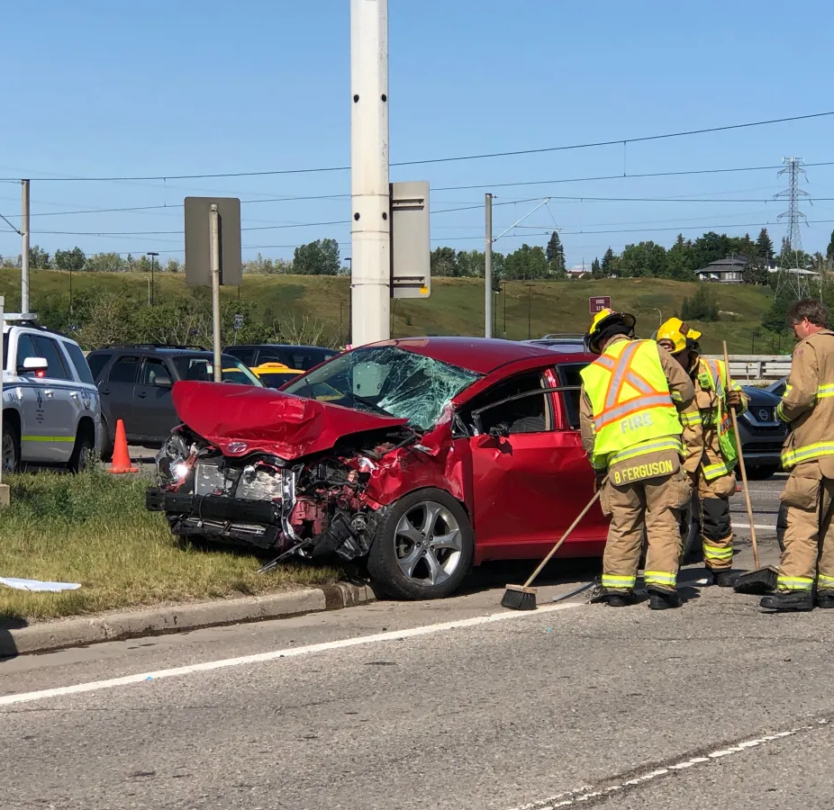
Scope of Analysis
1. Temporal Analysis:
Investigate collision frequencies over different time intervals.
Identify peak times, seasonal variations, and long-term trends.
2. Factor Analysis:
Examine primary factors driving collision occurrences.
Reveal complex interactions between variables influencing collisions.
3. Injury Distribution Analysis:
Examine distribution of injury types resulting from collisions.
Inform emergency response protocols and healthcare resource allocation.

Slide 6

Data Analysis and Visualization

Slide 7
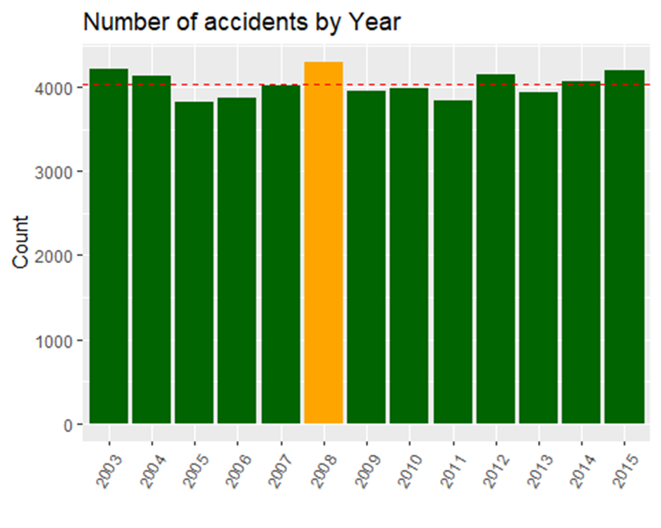
Number of accidents by years (2003 - 2015)
This visualization presents a comprehensive overview of collision frequencies over a 13-year period, highlighting long-term trends and changes.
Identifying years with unusually high or low collision rates can inform targeted interventions and policy reforms.
Visualizing collision data by year allows stakeholders to assess the effectiveness of road safety initiatives and allocate resources accordingly.
Trends observed in collision frequencies may prompt further investigation into underlying factors driving long-term changes in road safety.

Slide 8
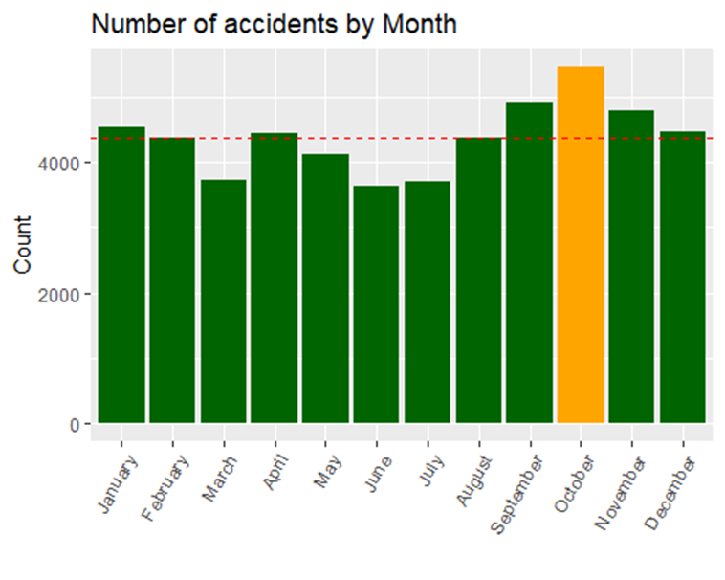
Number of accidents by months (January to December)
This visualization illustrates the seasonal variations in collision frequencies throughout the year, offering insights into weather-related patterns and holiday impacts.
Comparing collision frequencies across months enables stakeholders to allocate resources effectively, prioritizing interventions during peak collision seasons.
Trends in collision occurrences by month may uncover underlying factors such as weather conditions, road maintenance, and cultural events affecting road safety.
Visualizing monthly collision data facilitates data-driven decision-making and policy formulation to address seasonal variations in road safety.

Slide 9
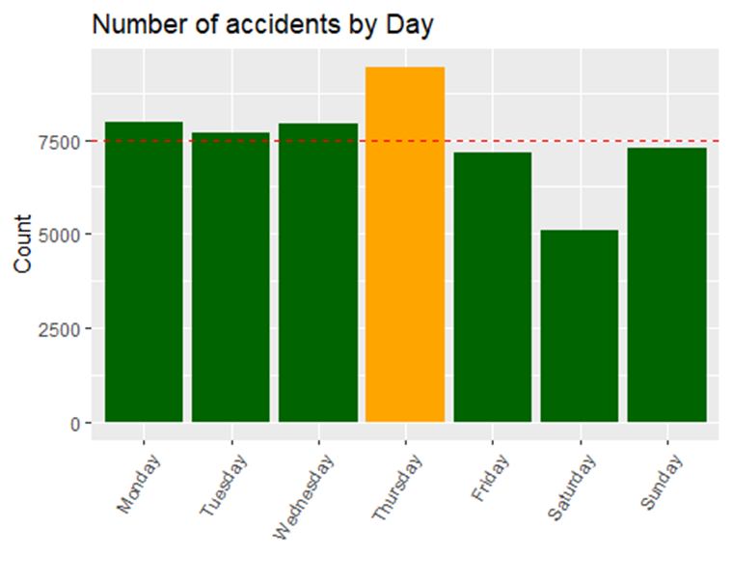
Number of accidents by days (Monday to Sunday)
This visualization provides insights into the distribution of collision frequencies across different days of the week, highlighting potential differences in driving behaviours and risk factors.
Understanding the distribution of collisions by day allows stakeholders to allocate resources effectively, focusing efforts on high-risk days to reduce road traffic incidents.
Trends in collision frequencies by day may reveal patterns such as commuting-related collisions on weekdays or leisure-related collisions on weekends.
Visualizing collision data by day enables stakeholders to implement evidence-based road safety measures tailored to specific days of the week.

Slide 10
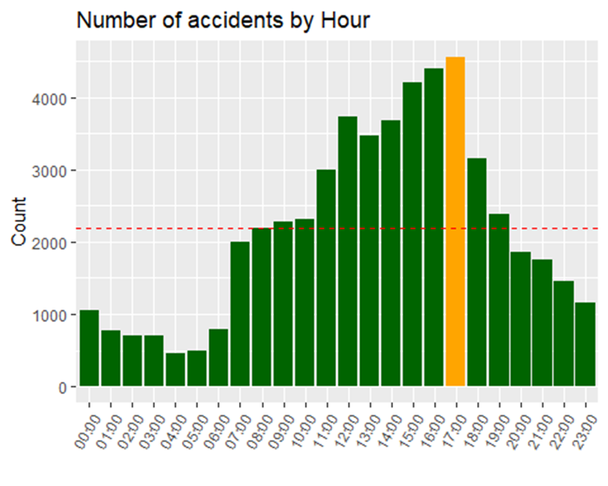
Number of accidents by hour (00:00 to 23:00)
This visualization offers insights into the temporal patterns of collision occurrences throughout the day, identifying peak hours and periods of increased collision risk.
Peaks and troughs in collision frequencies by hour help identify times of day with higher accident rates, guiding the allocation of resources for enhanced law enforcement and emergency response.
Understanding the distribution of collisions by hour allows stakeholders to implement targeted interventions such as traffic management strategies and public awareness campaigns during peak hours.
Trends in collision frequencies by hour may reveal patterns such as rush hour collisions or late-night accidents, indicating areas for focused intervention.

Slide 11
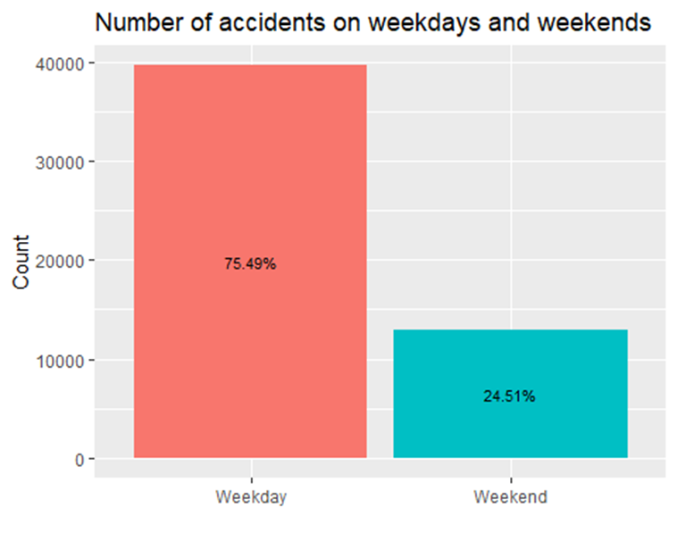
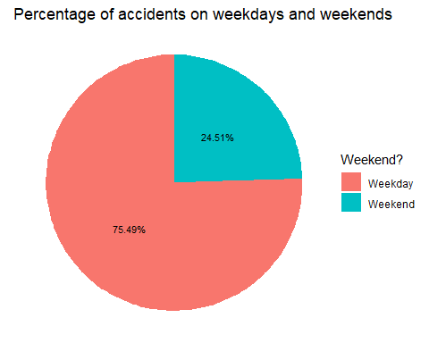
Number and rates of accidents on weekdays and weekends
Compare weekday and weekend accident numbers to identify patterns.
Identify high-risk periods for targeted interventions and heightened law enforcement.
Tailors' road safety measures to specific days, addressing unique challenges faced during weekdays versus weekends.
Reveals trends such as leisure-related weekend collisions, informing public awareness campaigns and educational activities.

Slide 12
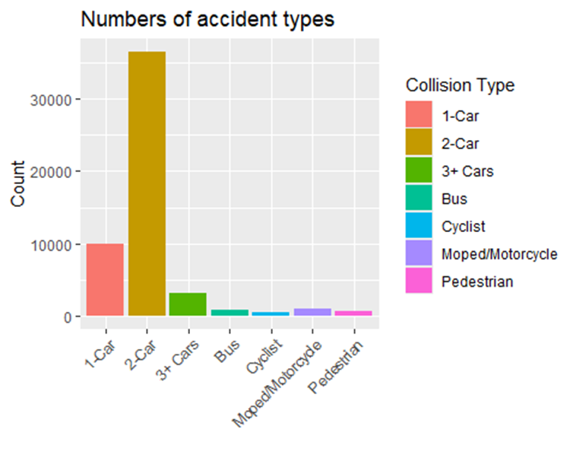
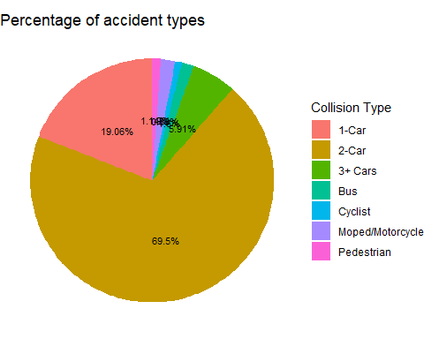
Numbers and rates of accident types
Presents the distribution and severity of different accident types, offering insights into their frequency and impact.
Prioritizes interventions by highlighting the most common collision types and their associated risks.
Identifies high-risk scenarios for targeted efforts, enabling proactive measures to prevent specific types of accidents.
Reveals trends such as increasing 2-Car collisions, prompting further investigation into contributing factors and mitigation strategies.

Slide 13
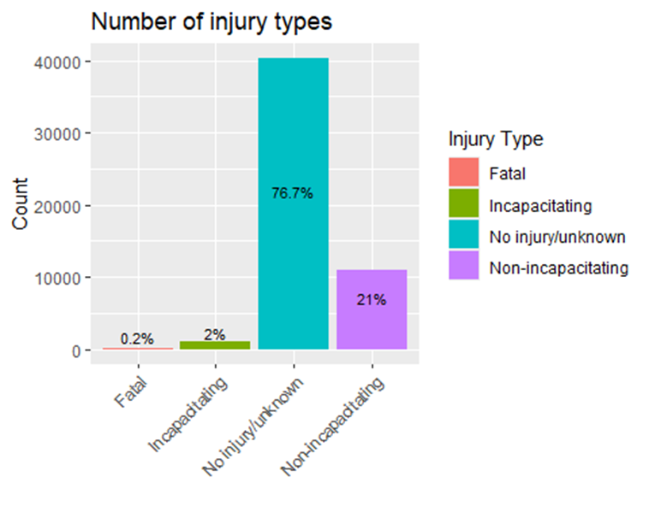
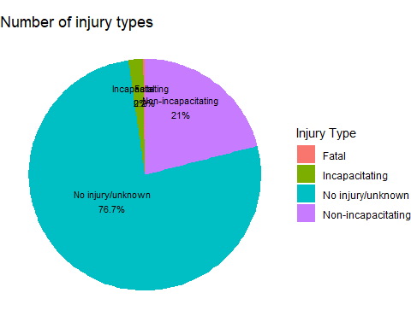
Numbers and rates of injury types in accidents
Examine the severity and frequency of various injury types resulting from accidents, providing a comprehensive understanding of their impact.
Tailors' emergency response and healthcare services to address the specific needs of individuals involved in different types of accidents.
Prioritizes interventions for severe injuries, ensuring timely and effective medical attention for those most in need.

Slide 14
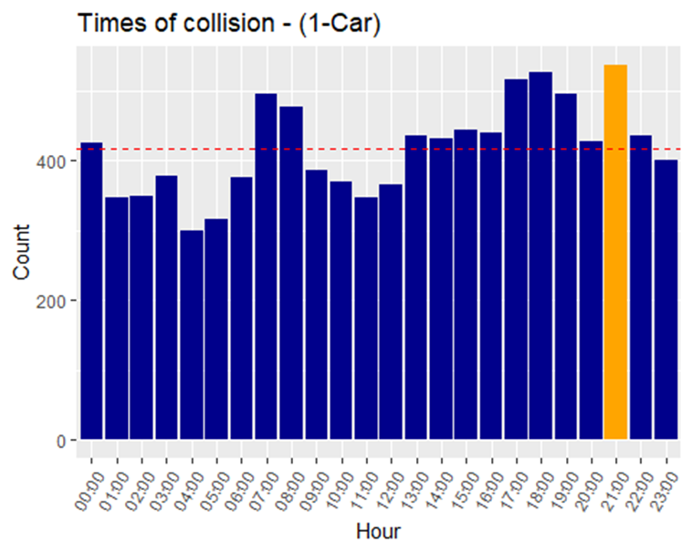
Times of collision - (1-Car)
Analyse the temporal patterns of collisions involving a single car.
Identifies peak hours for single-car collisions, facilitating targeted preventive measures.
Guides law enforcement efforts by focusing patrols during high-risk times.
Informs public awareness campaigns to promote safe driving behaviours during identified peak hours.

Slide 15
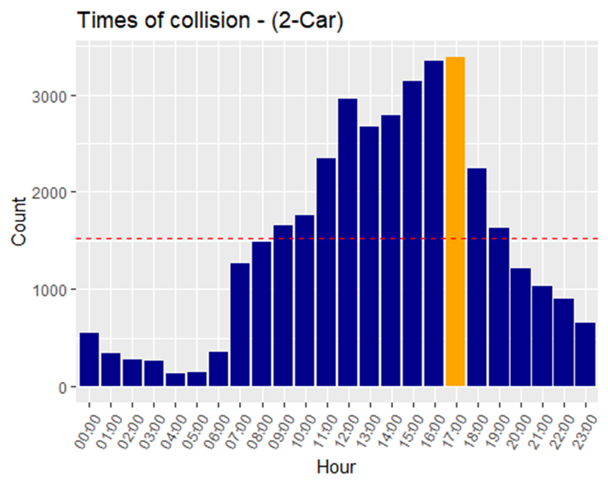
Times of collision - (2-Car)
Examines the temporal distribution of collisions involving two cars.
Identifies peak hours for two-car collisions, allowing for targeted interventions to reduce their occurrence.
Helps identify potential risk factors contributing to two-car accidents, such as intersections or congested areas.
Guides traffic management strategies, including signal timing adjustments and intersection redesigns.
Informs driver education programs by highlighting common scenarios leading to two-car collisions.

Slide 16
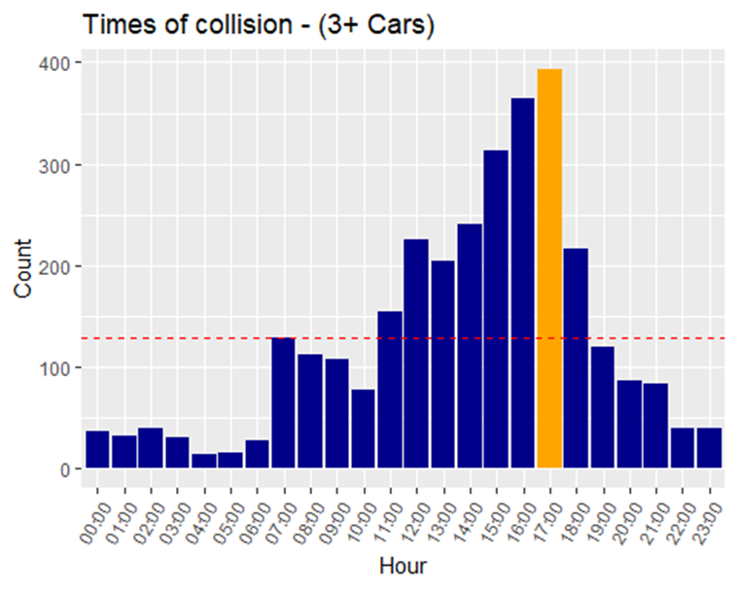
Times of collision - (3+ Cars)
Analysis the temporal trends of collisions involving three or more cars.
Identifies peak hours for multi-car collisions, enabling focused interventions to mitigate their frequency.
Helps uncover factors contributing to multi-car accidents, such as highway congestion or driver error.
Informs emergency response protocols by preparing for high-impact collisions during identified peak times.

Slide 17
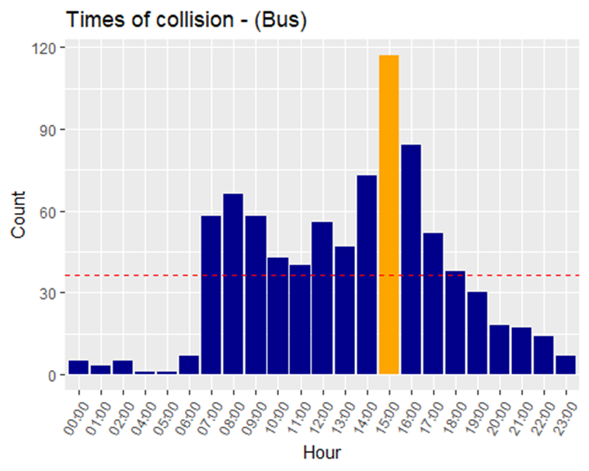
Times of collision - (Bus)
Examines the temporal patterns of collisions involving buses.
Identifies peak hours for bus-related collisions, allowing for targeted safety measures for both buses and other road users.
Helps understand factors contributing to bus collisions, such as bus routes or driver fatigue.
Guides transit agencies in scheduling and route planning to minimize collision risks.
Informs bus driver training programs by focusing on common collision scenarios during identified peak hours.

Slide 18
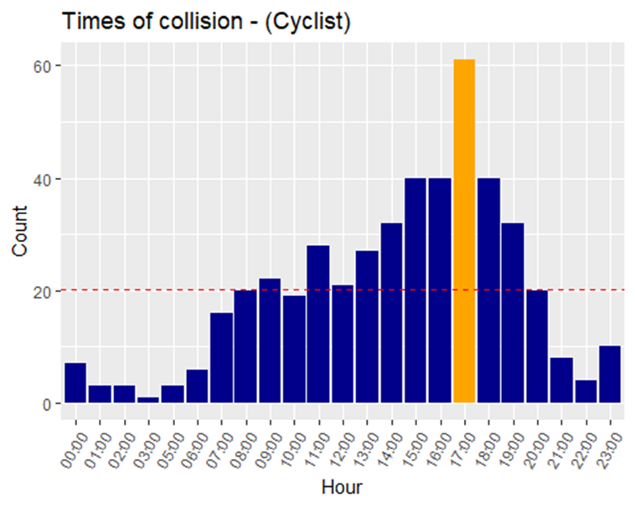
Times of collision - (Cyclist)
Analysis the temporal distribution of collisions involving cyclists.
Identifies peak hours for cyclist-related collisions, informing safety initiatives aimed at protecting vulnerable road users.
Guides urban planning efforts to create safer cycling routes and improve road design for cyclists.
Informs public education campaigns to promote cyclist awareness and safe driving behaviours during peak cyclist collision times.

Slide 19
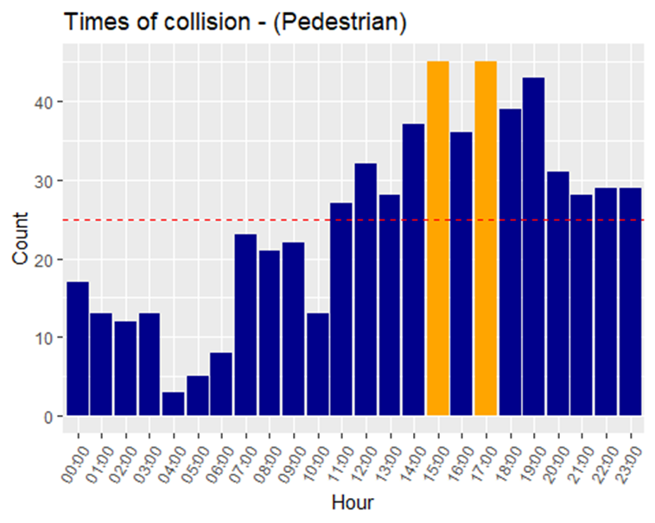
Times of collision - (Pedestrian)
Analysis the temporal distribution of collisions involving pedestrians.
Identifies peak hours for pedestrian-related collisions, informing safety initiatives to protect vulnerable road users.
Helps understand factors contributing to pedestrian collisions, such as crosswalk visibility or driver distraction.
Guides urban planning efforts to create safer pedestrian infrastructure and improve road design.
Informs public education campaigns to promote pedestrian awareness and safe driving behaviours during peak pedestrian collision times.

Slide 20
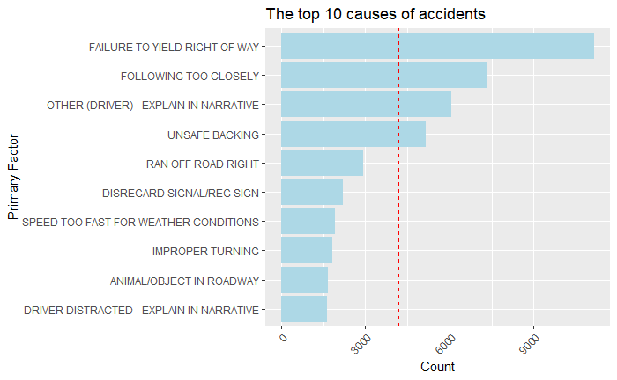
The top 10 causes of accidents

Slide 21
Conclusion
Data-driven approaches are crucial for addressing complex societal issues like road vehicle collisions.
Data visualization provides valuable insights into the causes, patterns, and outcomes of collisions.
Evidence-based interventions and policy reforms can be developed based on these insights.
Collective action is needed to create a culture of road safety and responsible driving behaviour.
Targeted infrastructure investments, public awareness campaigns, and technological innovations are essential for reducing collision severity.
Commitment to leveraging data and technology as catalysts for progress will empower communities and save lives, fostering a safer, more sustainable future for everyone.

Slide 22


Slide 23
References
Slide 1-6 Images
Yeung, J. and Chen, J. (2022). More than 200 cars involved in massive pileup in China’s Zhengzhou. [online] CNN. Available at: https://edition.cnn.com/2022/12/28/china/china-zhengzhou-car-pile-up-intl-hnk/index.html [Accessed 09 Apr. 2024].
Dahablaw.com. (2024). Motor Vehicle Accident – Dahab Law. [online] Available at: https://dahablaw.com/motor-vehicle-accident/ [Accessed 09 Apr. 2024].
https://www.facebook.com/digital.abhay.singh (2022). WHAT ARE THE EVERYDAY CAUSES OF MOTORCYCLE ACCIDENTS IN MICHIGAN. [online] Scoopearth.com. Available at: https://www.scoopearth.com/what-are-the-everyday-causes-of-motorcycle-accidents-in-michigan/ [Accessed 09 Apr. 2024].
Carter, M. (2020). A List of Car Accidents by State: Where It’s Most Dangerous To Drive. [online] Injury Claim Coach. Available at: https://www.injuryclaimcoach.com/car-accidents-by-state.html [Accessed 10 Apr. 2024].
Pearson, H. (2019). 1 person taken to hospital after multi-vehicle collision on Memorial Drive. [online] Global News. Available at: https://globalnews.ca/news/5770374/calgary-multi-vehicle-crash-memorial-drive/ [Accessed 10 Apr. 2024].
Udacity.com. (2024). Data Analyst Online Course | Data Analytics | Udacity. [online] Available at: https://www.udacity.com/course/data-analyst-nanodegree--nd002 [Accessed 11 Apr. 2024].
Graphs from analysis section: My repository
Dataset for Data Analysis and Visualisation:
Jackson Divakar R (2024). Car Crash Dataset. [online] Kaggle.com. Available at: https://www.kaggle.com/datasets/jacksondivakarr/car-crash-dataset [Accessed 02 Apr. 2024].

